Slide 1
Time Delay Calibration
Using Reflex Protocols
Note:
To determine your monitor response time, we will be running the reflex protocol and recording 10 trials in slow motion. Try to use a phone with a high fps (>500 fps) for slow-mo (check settings). By recording and comparing to PsychoPy’s output, we can subtract to find the time delay for the stimulus to appear on the screen. Remember to use your typical experimental set up.

Slide 2
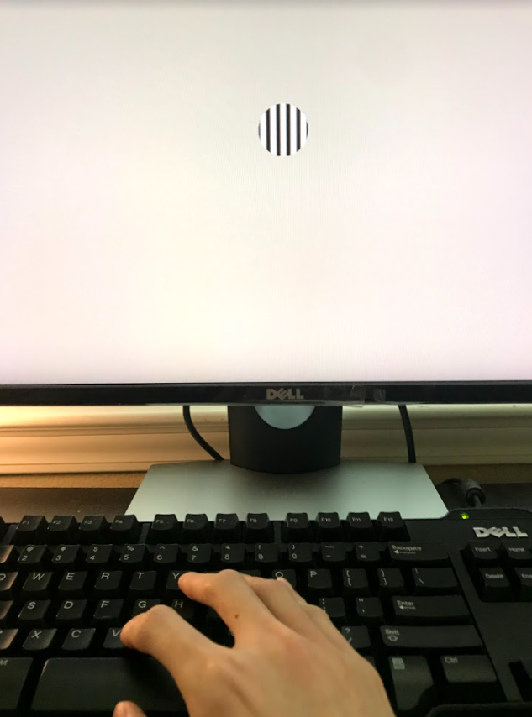
Set-Up
Use a real reflex protocol and constrict the eccentricity so the stimulus only appears in the center. Run 10 trials.
Timer Starts
~50 ms lag
Image Appears
~200 ms
Reaction
After recording 10 trials, use another software to go frame by frame (Adobe Premier has a free trial for doing this)
Watch your video and record the times for when the stimulus appears and when you fully depress the key. Calculate the difference to find your true reaction time. This is demonstrated on the next slide.
Make sure the video captures the mapped key. You will need to be able to see when the key is fully pressed.

Slide 3
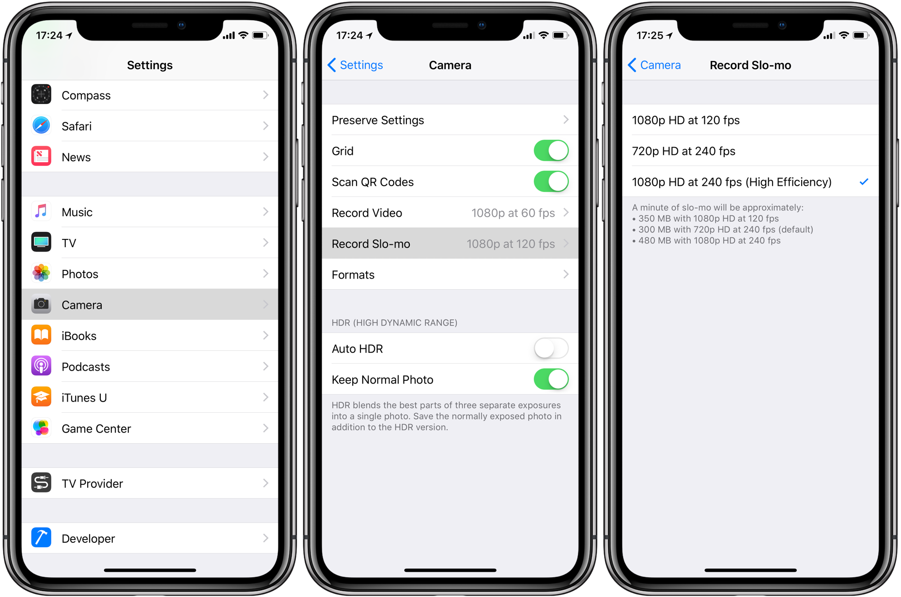

Slide 4


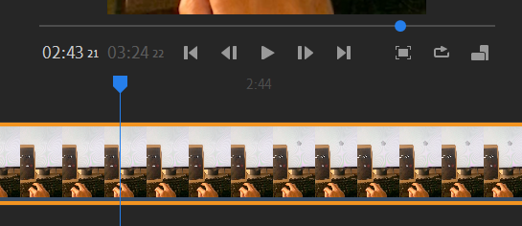
Using Adobe Premier Rush
When stimulus becomes fully opaque
When key is fully depressed
Trial 1: 2:43 21 - 2:44 15 → 24 frames
Advance one frame
The small digits indicate the frame number. This app will play back the video with 30 frames per second.
To convert slow-mo to real time:
Check the “fps” your phone records in. If your phone uses 960 fps, one second in real time has been recorded in 960 frames. Since 30 frames are being shown per second in the slow mo video, one second in real time has been converted to 960/30 = 32 seconds in the video playback.
Count the number of frames between the stimulus and the key press. Video RT = # of Frames
Then calculate the Video RT using the equation to the right. FPS Your Phone Records In

Slide 5
Note About Using Adobe Premier Rush
Uploading the slow-mo video to Adobe directly may cause the video to revert to normal speed. To avoid this, save the video to “Files” first, then upload the file to the Adobe app.
Your video MUST be in slow motion when analyzing on Adobe Rush. Play the video within the app to ensure it is.

Slide 6
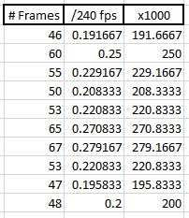
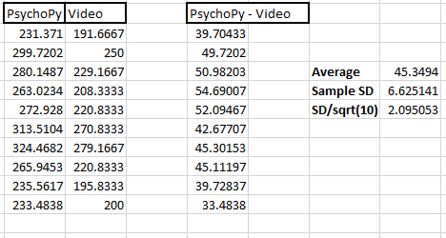
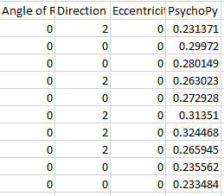
Units:
(sec) (ms)
PsychoPy RT Output
(Containing Monitor Delay)
Reaction Time Determined by Video Analysis
Your typical data sheet, automatically generated
Found by counting the frames between when stimulus fully appears on screen and the time of the click

Slide 7
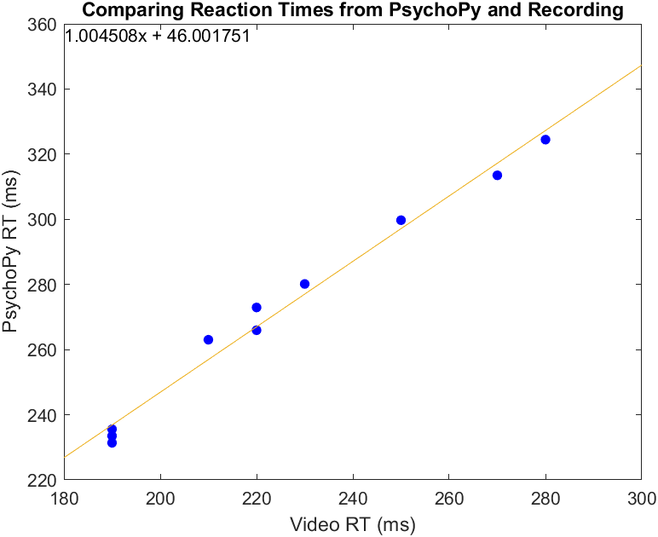
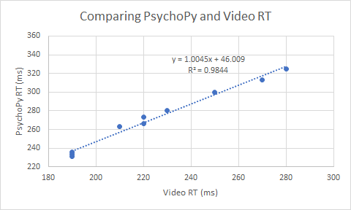
Using MATLAB or Excel,
Plot PsychoPy RT over Video Analysis
Check that the correlation is strong (R² = ~0.98)
Slope should also be ~1

Slide 8
Report:
Slope
R²
Average
Standard Error (SD/sqrt(10))
Fill in your results on your slides!
Calculate the difference between PsychoPy and Video RT to get the monitor response time (time delay).

